Slide 1
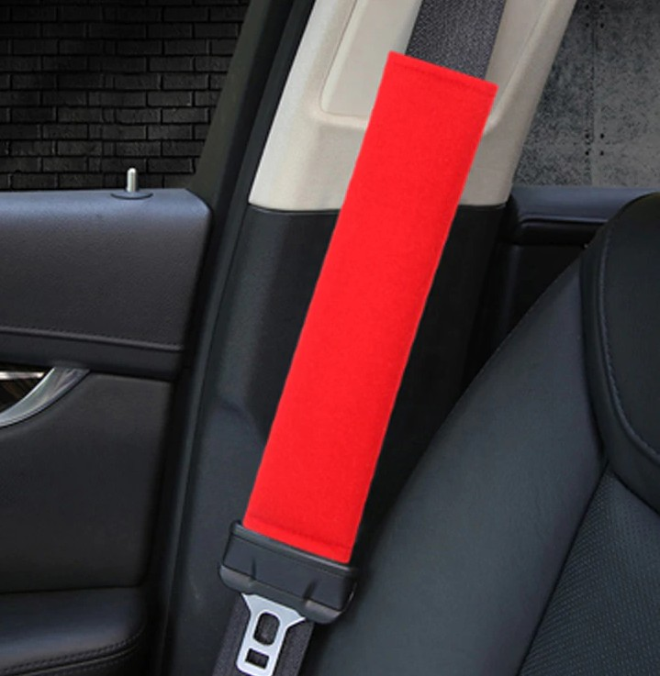


Slide 2
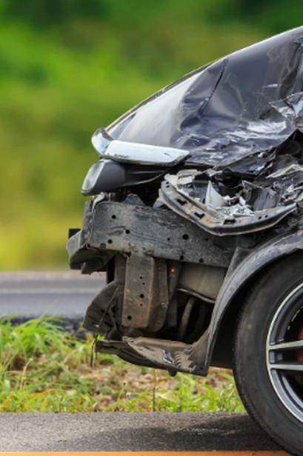
OVER 100 000 CAR
ACCIDENTS IN 2019

Slide 3

AFTER A CAR ACCIDENT, EVERY SECOND
IS CRUCIAL...
THAT IS WHY WE HAVE CREATED A
PRODUCT THAT WILL SAVE THE MEDICAL TEAM LOADS OF TIME AND HELP THEM
WORK MORE EFFICENTLY.

Slide 4
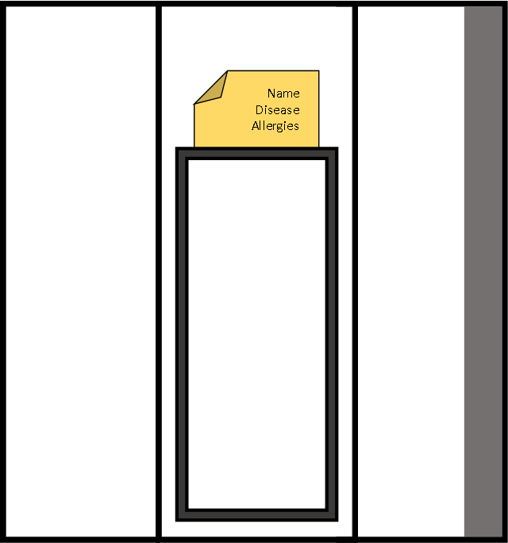
DISCOVER

Slide 5
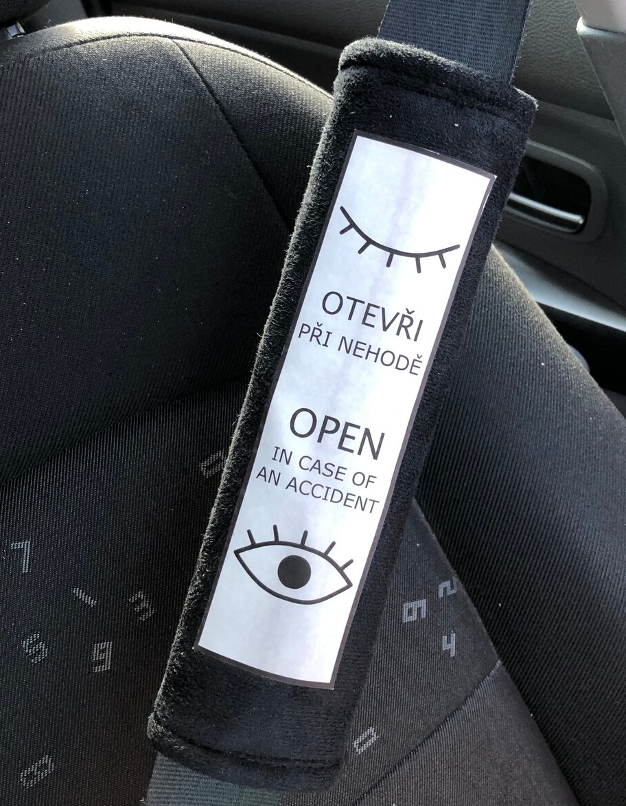
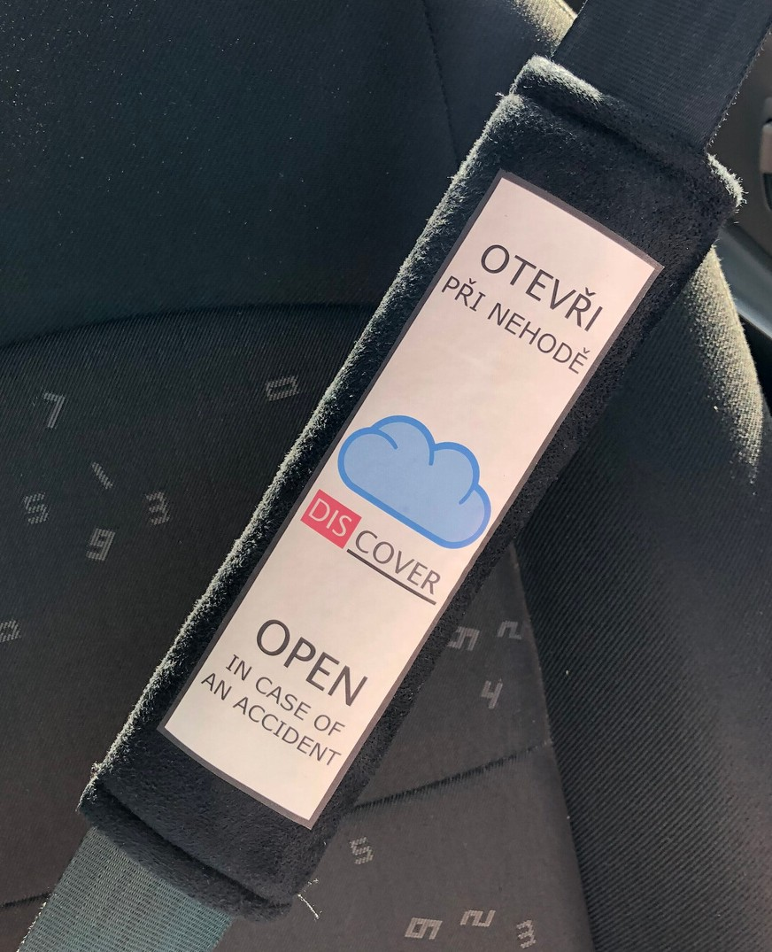
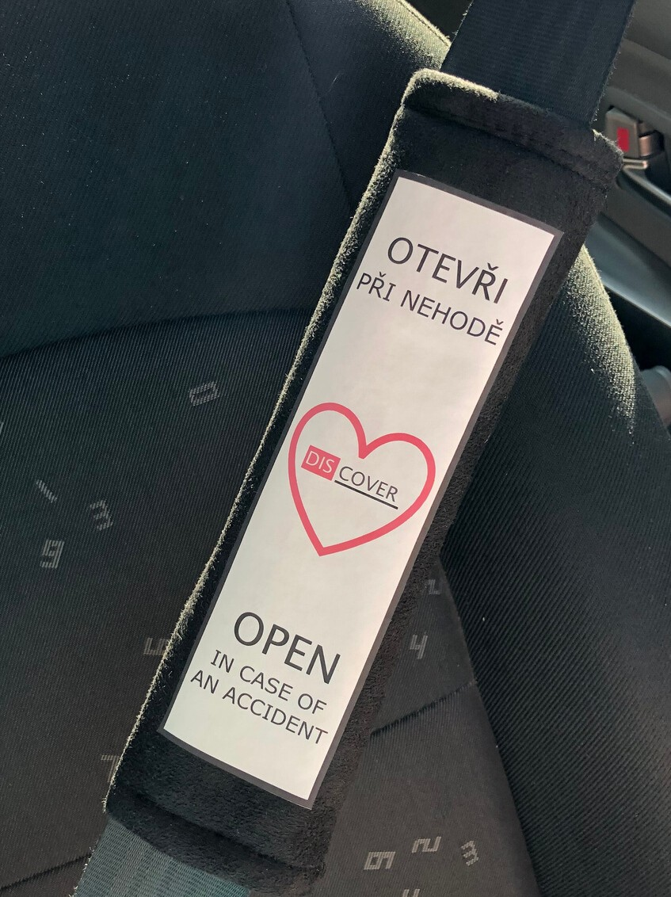
DESIGNS

Slide 6
HOW IS IT CREATED ?
FIR S T | S TE P | CREATION | OF | THE | SEAT | BELT | COVER
S E COND | S TE P | CREATION | OF | THE | IDENTIFICATION | CARD
THIR D | S TE P | PACKING | AND | EXPEDITION | TO | CUSTOMER

Slide 7
WHY DISCOVER?
COMFORTABLE
SAFE
UNIQUE
ELEGANT

Slide 8

BUY OUR PRODUCT
WWW. NAVLEKYDISCOVER. EU
HERE
DISCOVER 2019 @ SEZNAM. CZ
+ 420 739 365 905

